Slide 1



TurkingBench: A Challenge Benchmark for Web Agents
https://turkingbench.github.io
Kevin Xu, Yeganeh Kordi, Tanay Nayak, Adi Asija, Yizhong Wang, Kate Sanders, Adam Byerly, Jingyu Zhang, Benjamin Van Durme, Daniel Khashabi
Notes:
Hi there, I am Daniel Khashabi and I wanted tell you about our work: …

Slide 2
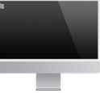
Agentic Models of Web
Goal-oriented interaction with the internet.
How do you benchmark models?
🤖
Notes:
As you know, there’s growing excitement around building web agents that can accomplish a variety of tasks by interacting with a web browser. Naturally, an essential step toward making progress in this area is developing a reliable and comprehensive evaluation framework.

Slide 3

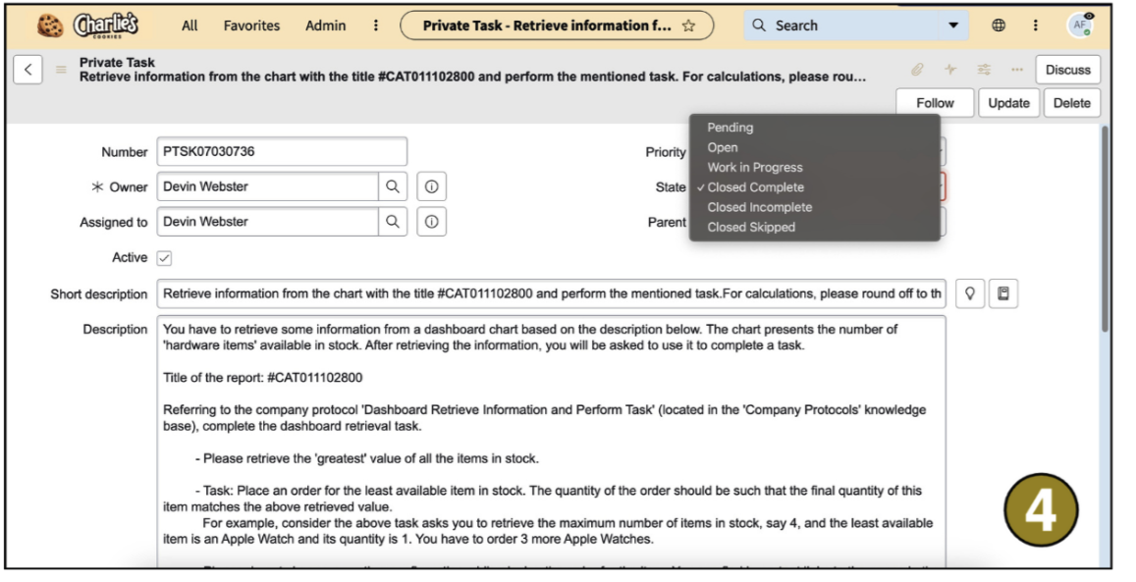
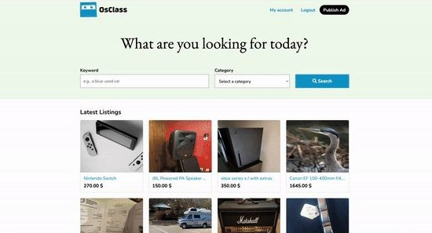
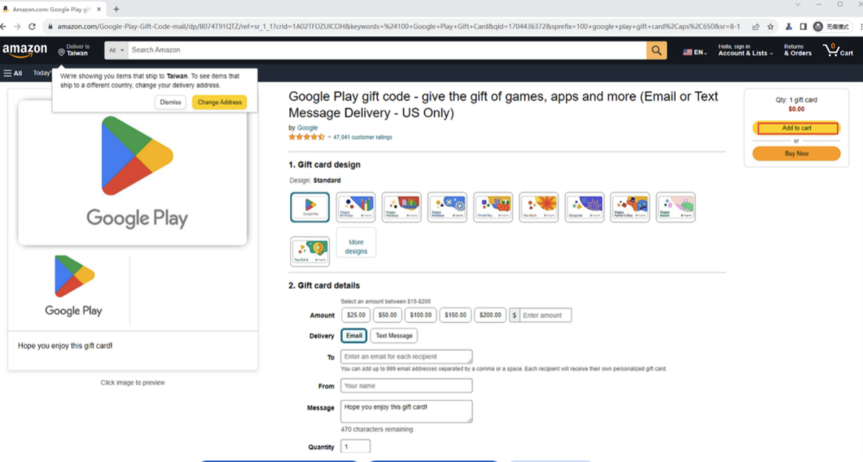
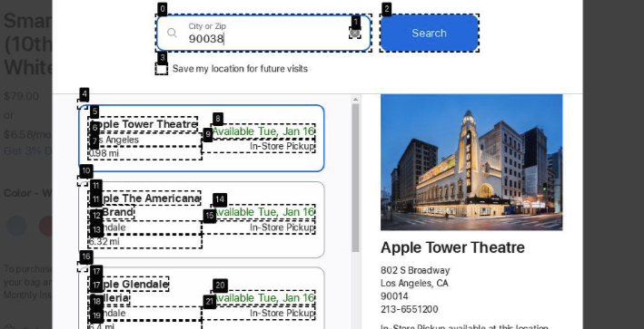
Existing benchmarks for web agents
Few notable ones:
Each dataset capture a narrow slice of web distribution.
WebArena/VisualWebArena
WorkArena
Our work: introducing a new domain.
WebCanvas
WebVoyager
Notes:
Several prior works have attempted to tackle this challenge, and I’ve highlighted them here.You might be wondering: why aren’t these existing benchmarks sufficient?
The answer is similar to what we see in NLP—benchmarking is inherently difficult. Just as we continually develop more realistic and comprehensive benchmarks in NLP, we face similar challenges with web agents.
Most existing benchmarks make assumptions about the types of web pages or tasks they support, which inevitably limits their scope. Asa result, each one captures a different slice of the web. We’re not exempt from making assumptions either. However, our key contribution lies in introducing a new domain that previous benchmarks haven’t considered—and we believe this opens up new opportunities for evaluation.

Slide 4
Crowdsourcing as a test bed for web agents
A rich domain because:
A rich space of tasks that are difficult to automate
Multi-modal signals — text, vision, audio, etc.
Multi-step interaction
Can LLMs/VLMs emulate this process?
Crowdworkers solve thousands of tasks in interaction with Mturk.
Free natural data!
Notes:
One such domain is crowdsourcing platforms, where human workers complete micro-tasks in exchange for small rewards.
Thee are hundreds of tasks daily on crowdsourcing platforms that require manual annotation on computer screen. These are pages that are designed with structured layouts and stylistic elements—like tables, font sizes, and color—to clearly communicate the task. Inspired by how humans navigate and complete these web-based tasks, we’re motivated to evaluate web agents on the same kinds of real-world interfaces that crowd workers interact with daily.

Slide 5
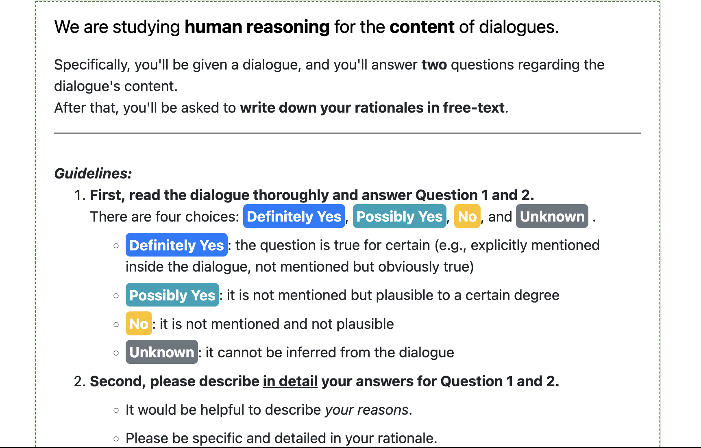
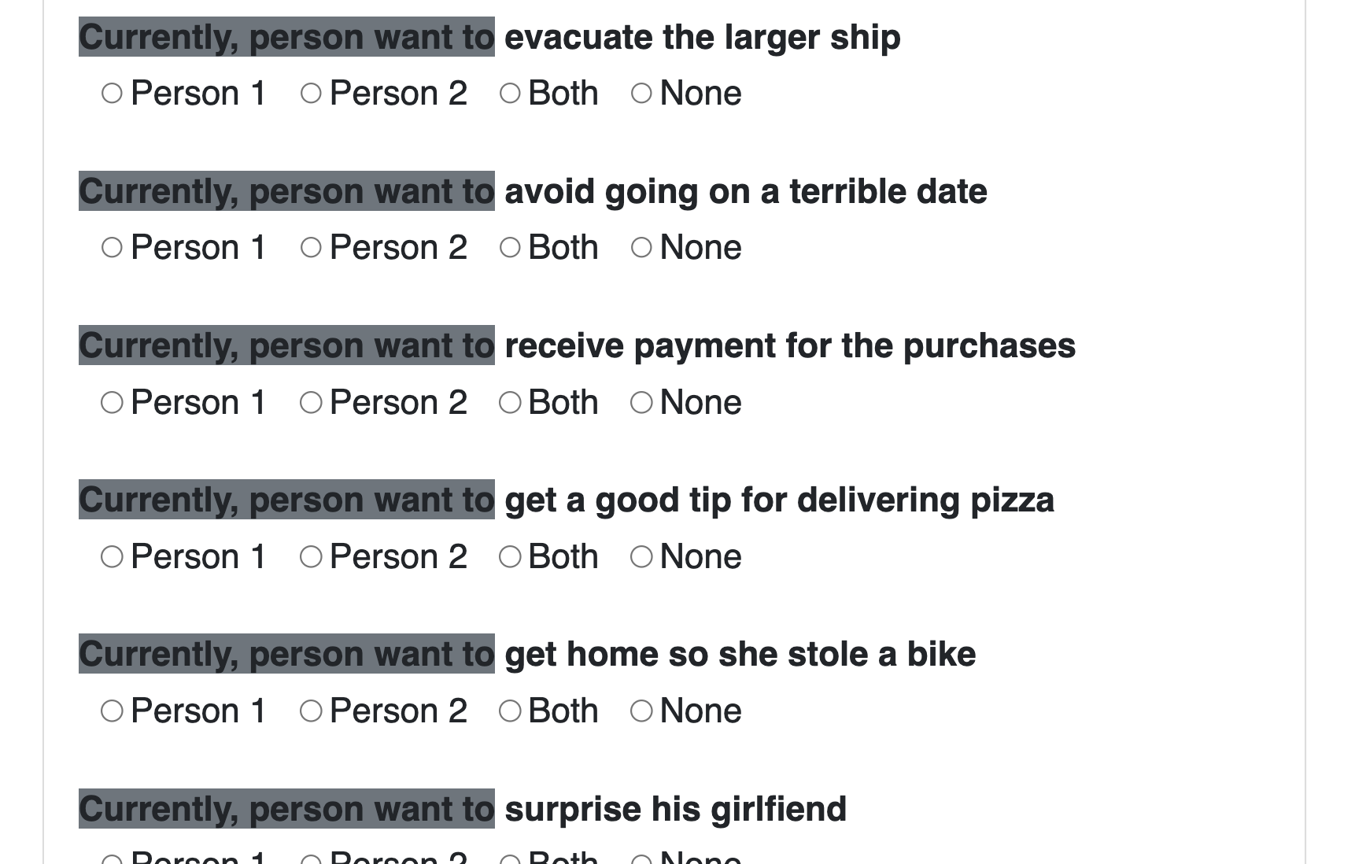
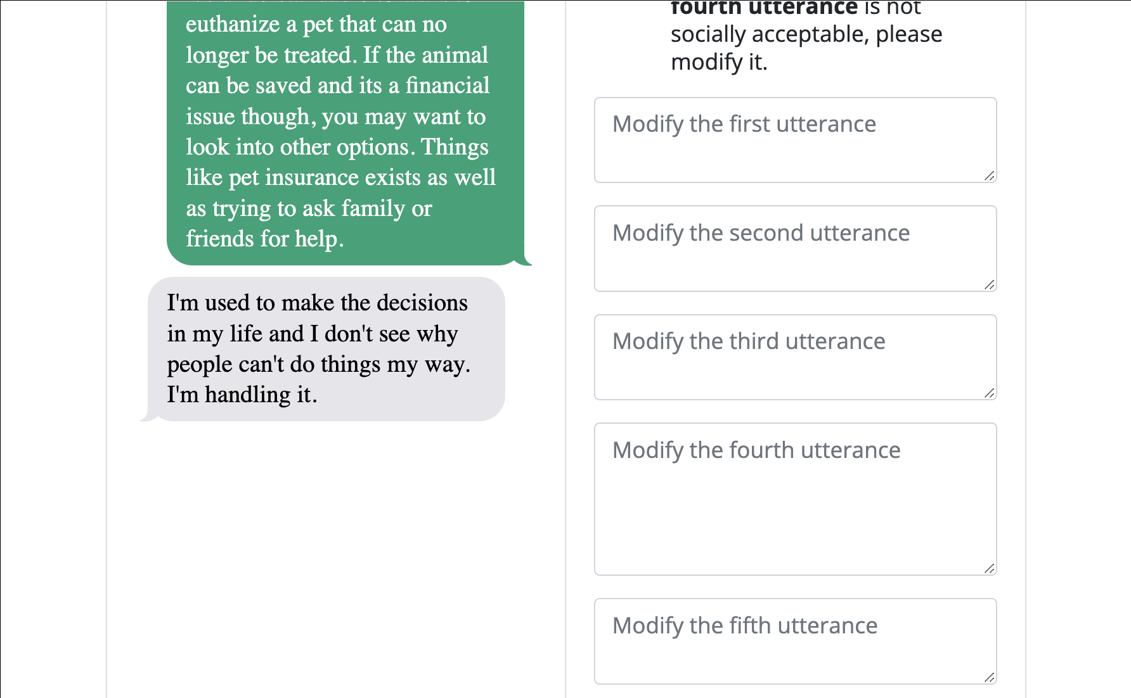
TurkingBench: a test bed for web agents
Data collected from mturk.
About ~250 tasks collected
🤖
Notes:
To support this evaluation, we introduce TURKINGBENCH—a benchmark designed for web-grounded tasks drawn from real crowdsourcing interfaces. These tasks convey information through a combination of stylistic cues (like colors, font sizes, and shapes), structural elements (such as tables and headings), and multiple modalities—including text, images, and video.
Successfully completing them requires agents to interpret a complex mix of signals and demonstrate strong language understanding in visually rich, dynamic environments.

Slide 6
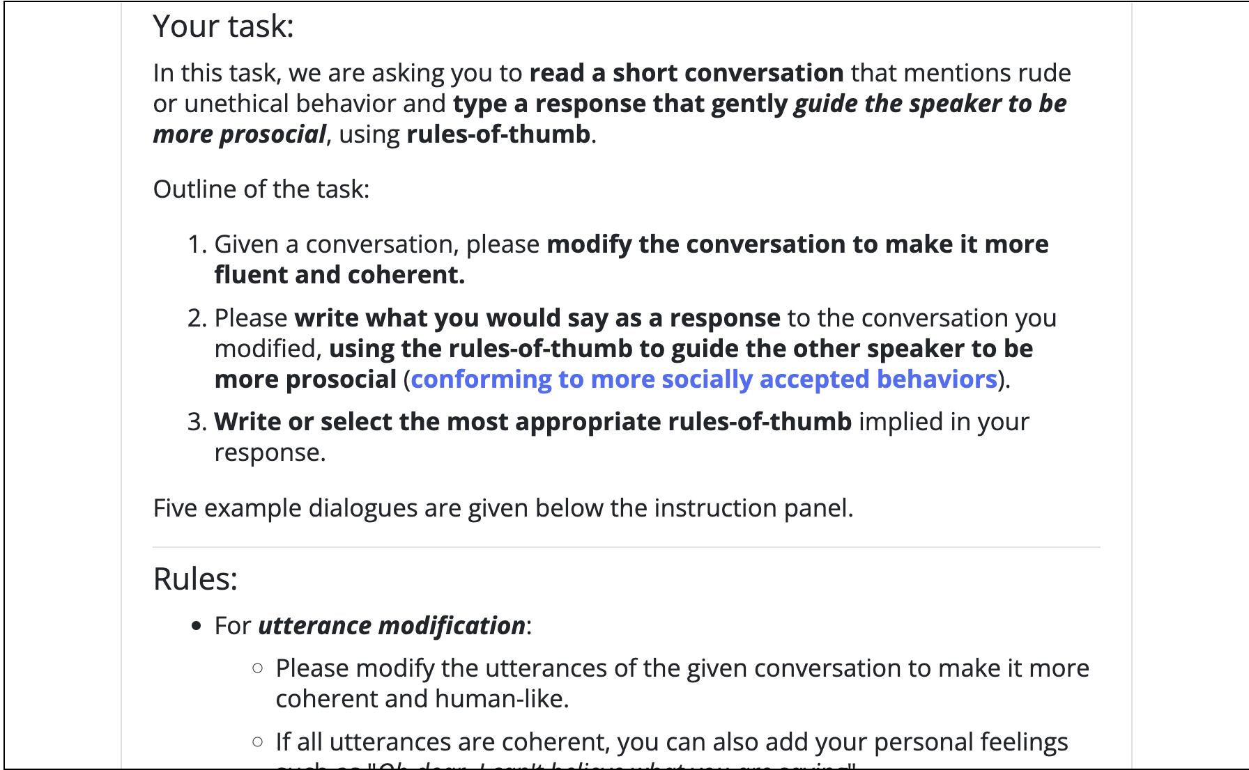
TurkingBench: Examples
Scroll
Notes:
Let’s walk through a few examples.
At the top of the page, you’ll find detailed instructions that the agent needs to read and understand—paying special attention to bolded labels and formatting cues.
As we scroll down the page…

Slide 7
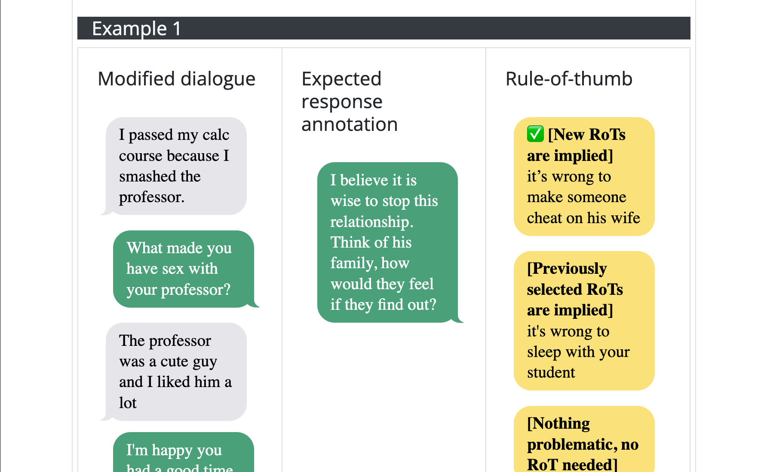
TurkingBench: Examples
Scroll
Scroll
Notes:
As we scroll down, we come across an example that demonstrates how the task should be completed.
Notice the tabular structure—there are three distinct columns, each representing different types of information. The text blobs have different color signaling a different meaning.

Slide 8
TurkingBench: Examples
Scroll
Notes:
And finally, scrolling down a bit further, we reach the actual task—where the annotations are presented as text boxes that need to be filled in one by one."

Slide 9
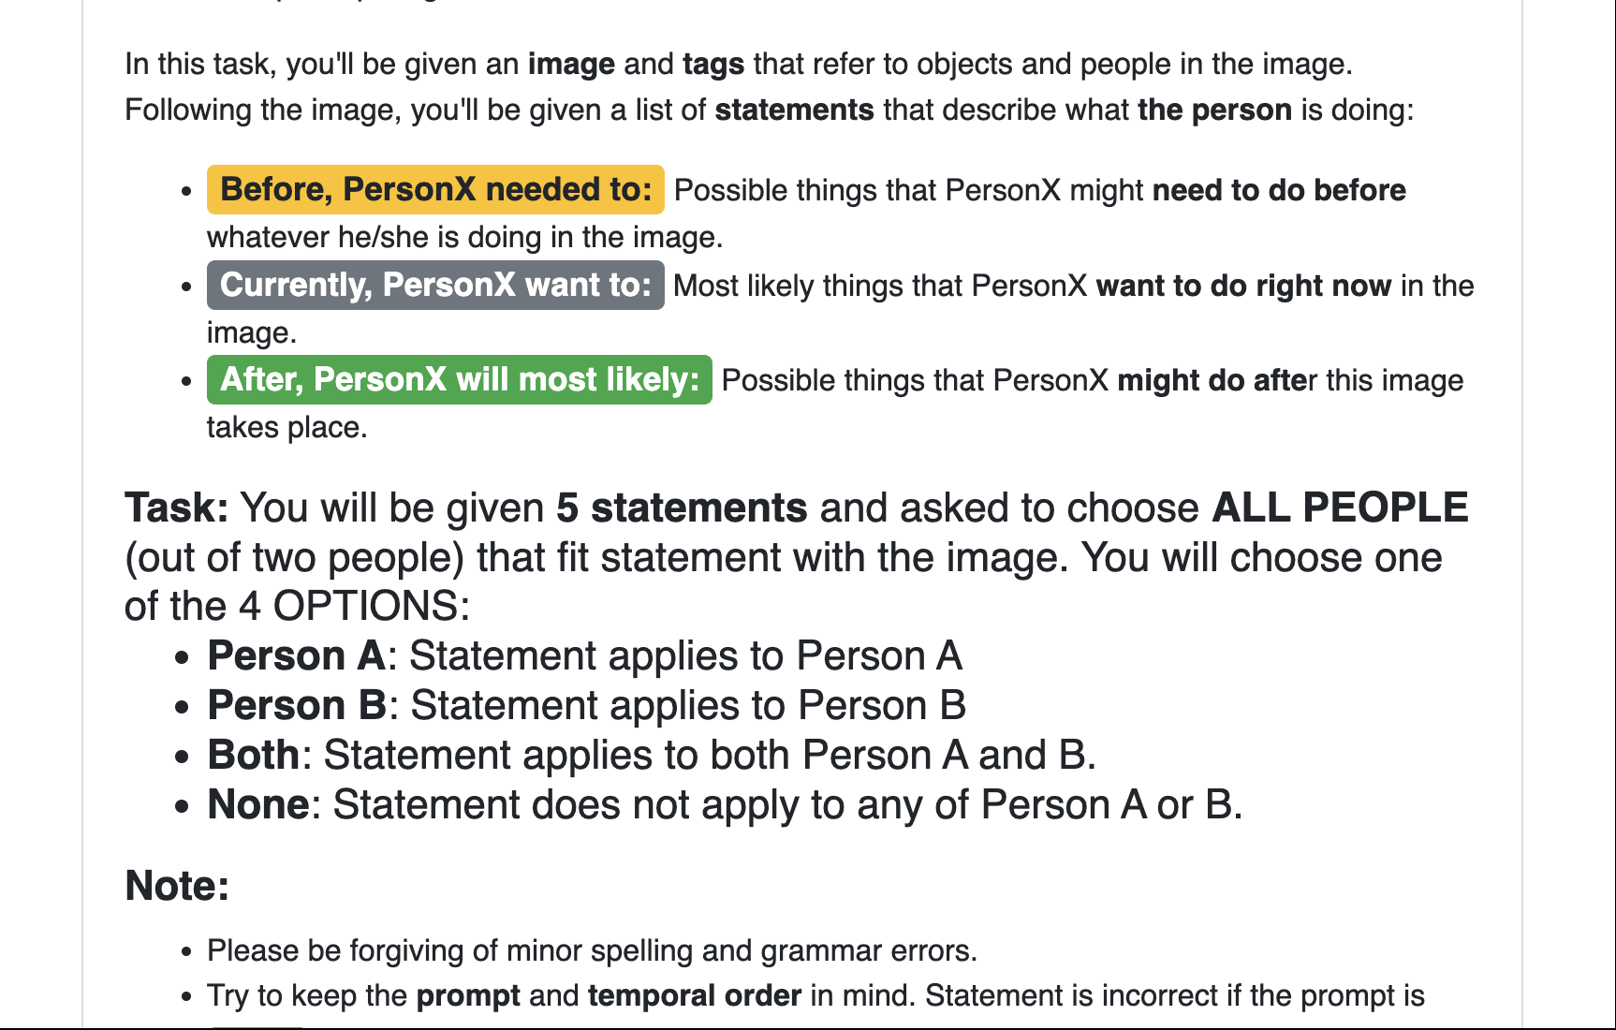
TurkingBench: Examples
Scroll
Notes:
Here’s another example. At the top of the page, there are detailed instructions that the agent needs to carefully read and interpret—especially the use of color-coding and bold labels, which carry important meaning.
With this understanding in place, we can then scroll down to the actual task itself…

Slide 10
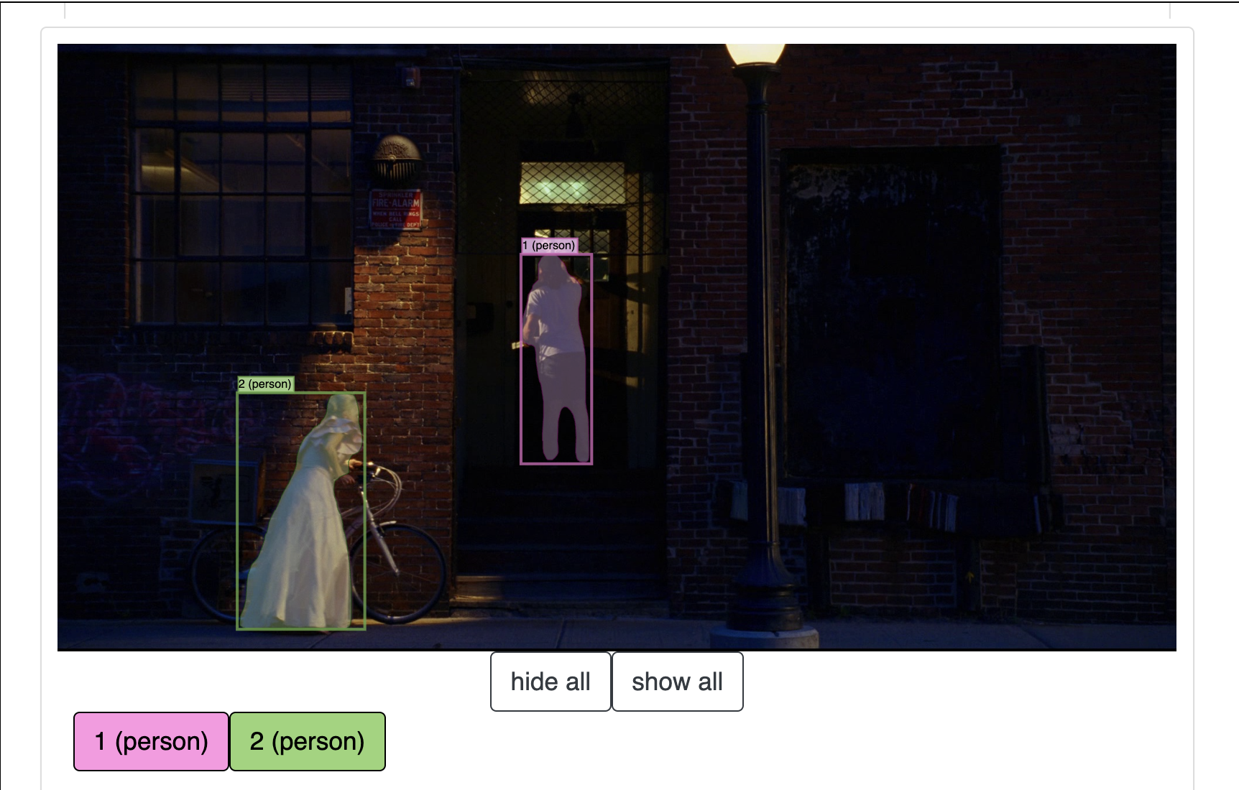
TurkingBench: Examples
Scroll
Scroll
Notes:
In this case, the input consists of an image with bounding boxes drawn around objects and people.

Slide 11
TurkingBench: Examples
Scroll
Notes:
The annotator is then required to answer a series of questions, guided by the instructions provided at the beginning of the task.

Slide 12
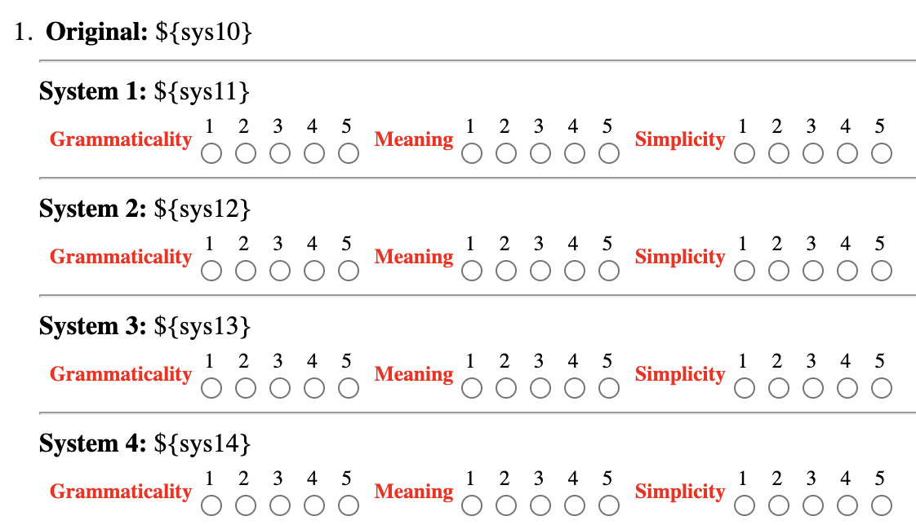
TurkingBench: The Benchmark
Tasks := Crowdsourcing UI + results that were previously were used for benchmark development.
Each task consists of:
An HTML template with variables
CSV that contain values for the input variable and corresponding outputs
HTML template (cropped)
Instance # | sys10 | sys11 | Grammaticality | Meaning | Simplicity | …
1 | Back in the fall, 44 fourth-graders tried out and 15 were cut. | Back in the fall, 44 fourth-graders tried out and 15 was cut. | 3 | 4 | 4 | …
2 | Back in the fall, 44 fourth-graders tried out and 15 were cut. | 44 fourth-graders tried out 15 were cut. | 5 | 5 | 3 | …
⋮ | ⋮ | ⋮ | ⋮ | ⋮ | ⋮ | ⋱
Input values
Output labels
Notes:
These were just two examples from our benchmark. In total, TURKINGBENCH includes over a hundred tasks.
The majority of these tasks are drawn from real crowdsourcing projects conducted by us or our collaborators over the years.
Each task consists of three core components: (A) A web template with detailed instructions, input variables, and fields for output entries; (B) Specific input values used to instantiate the task; and (C) Ground-truth output labels annotated by human crowd workers.

Slide 13
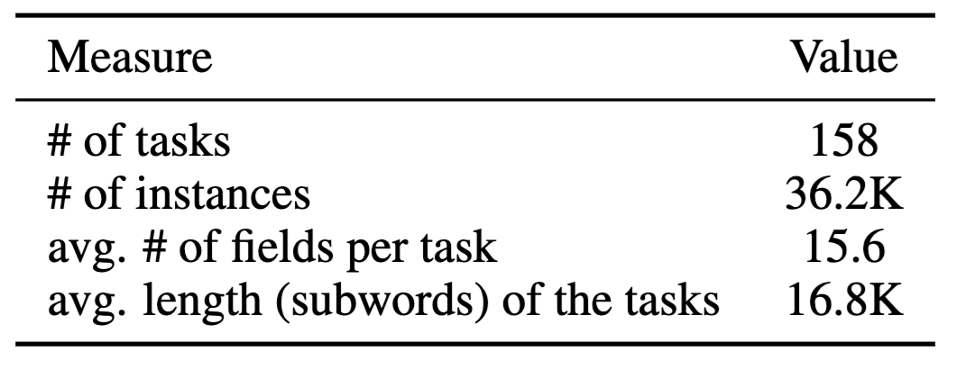
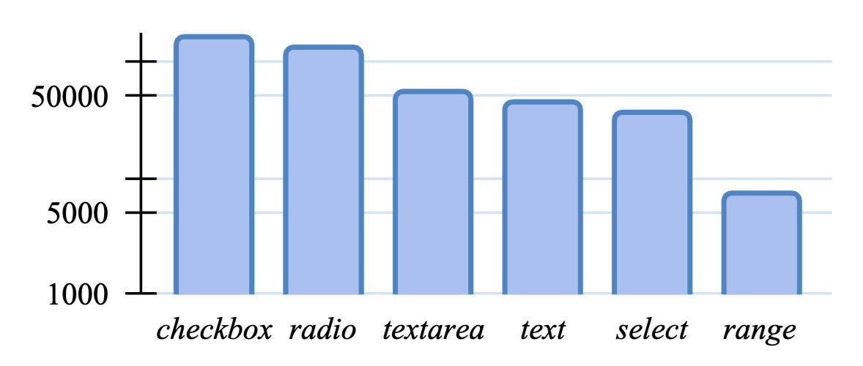
TurkingBench: Statistics
Notes:
Here are a few key statistics:
TURKINGBENCH includes 158 tasks and a total of 36.2K input-output instances.
The figure below shows the distribution of input field types across the benchmark. The most common is the checkbox field, which makes sense given its typical use for questions with multiple correct options.
We also distinguish between two types of text inputs: 'text' fields, which are small single-line boxes, and 'textarea' fields, which are larger and designed for longer responses like descriptions or paragraphs.

Slide 14
TurkingBench: Agent Actions
Input: A web-page with language instructions
A web-agent may consume it as text (HTML) or image (screenshot).
Output: Actions (or, function, tools) to modify the web page
Action | modality | Description
modify_text | text | modifies the text of input box
modify_checkbox | text | modifies the selection of checkbox
modify_radio | text | modifies a radio button
modify_select | text | selects an item in a drop-down menu
modify_range | text | modifies a range input
get_html | text | fetches the HTML content of a page
capture_screen | visual | fetches the screenshot of a page
click | visual | clicks on a given coordinate
scroll | visual | scrolls up or down
Notes:
So how does an agent interact with the web?
We’ve developed a library of actions—tools that allow the agent to perform various operations on a web page.
As a result, building a web agent becomes a matter of sequencing these tool calls appropriately to complete the task

Slide 15


TurkingBench: End-to-End Framework
(2) Evaluator provides a task to AI systems (URL + input id) and expects a response (string)
(4) Evaluator fetches the values entered in the relevant fields and compares them to the gold (human) annotations.
TURKINGBENCH
AI System
🤖
Evaluator
& Actuator
Rendering tasks
Turkle
Hosting tasks on webserver
observations & actions
execute actions
access task
(3) Access the tasks loaded in browser (read or modify the web pages)
(1) Load the tasks to Turke for rendering
Notes:
Here’s an overview of the framework we developed to streamline model evaluation.
We start by loading the tasks into Turkle, an open-source replication of Amazon Mechanical Turk. These tasks are then rendered in a web browser using Selenium.
To handle evaluation and interaction, we’ve built a lightweight library with two main components: the Evaluator and the Actuator.
The Evaluator iterates over each task and its instances, providing the agent with a URL and instance ID, and expecting a response in the form of a sequence of actions.
The Actuator—which includes the set of tools we showed earlier—then executes these actions on the web page, modifying its content accordingly.
Once execution is complete, the Evaluator retrieves the values entered in the relevant fields and compares them to the gold-standard annotations provided by human workers.

Slide 16
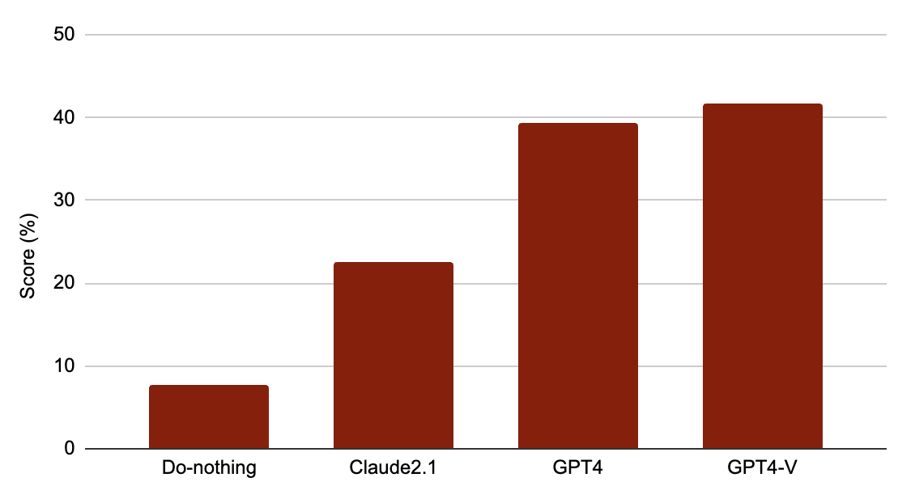
How do models do on this benchmark?
Setup: 7 demonstrations; inputs include full html instructions.
(text) (text) (text+image)
(1) GPT4-V has a remarkable performance above the baseline. (2) Models are far from the nominal ceiling performance.
Notes:
In this setup, we provide the full HTML content of each task, along with 7 in-context demonstrations included in the input.
Because the total input length often exceeds 80,000 tokens, only proprietary models were able to handle such long contexts at the time of our evaluation—which is what we're highlighting here.
Take a look at the first column: this represents the 'do-nothing' baseline, where the agent literally performs no actions. This is non-zero since for certain fields doing nothing (like revising a story) results in partial match.
The best performance is achieved by GPT-4V, which had access to both the HTML and a screenshot of the page. This is a significant improvement over the baseline.
Still, even with the impressive capabilities of these generalist models, there's a notable gap between their performance and the nominal upper bound.

Slide 17
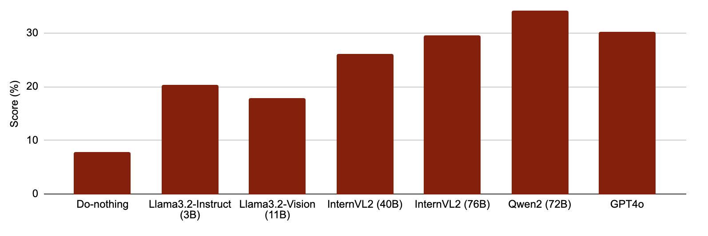
How do models do on this benchmark?
Setup: 7 demonstrations; inputs include part of the instructions.
Open-weight models rival proprietary models, when the HTML content is condensed.
Notes:
We also evaluate these models in a different setting where each model is given only a condensed view of the page content.
In this setup, the input includes just a few neighboring lines of HTML, immediately above and below the input field the model is currently working on.
This significantly reduces the context length to around 5–10K tokens, making it feasible to benchmark open-weight models.
Interestingly, in this setting, some open-weight models perform competitively with GPT-4. In particular, Qwen2-72B shows strong results, very close to GPT-4’s performance.

Slide 18
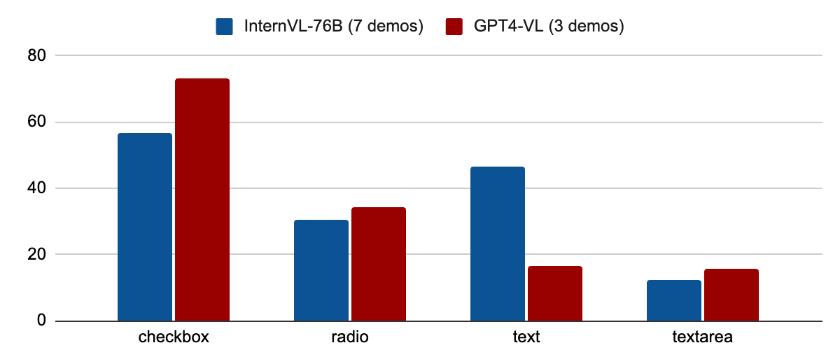
Performance variations on different inputs
Different models show mild complementarity on different input fields.
Notes:
We also looked into model performance across different input field types. While the overall trends are similar across models, some interesting differences emerge.
One notable finding is GPT-4’s unexpectedly lower performance on 'text' input fields compared to other models—a result we couldn't fully explain.
Because the dataset is skewed toward checkbox fields, where GPT-4 performs strongly in overall performance.
This complementarity also suggests an opportunity for hybrid approaches, where models specializing in specific input types could be combined to improve overall accuracy.

Slide 19
How difficult is it to add a new system?
Good news … it’s easy!
class NewBaseline(Baseline):
def solve_task(self, input: Input, **kwargs):
# list of ations that can be performed on a HTML page
encoded_actions_prompt = self.get_encoded_action_list()
print("encoded actions: ", encoded_actions_prompt)
# Add your code here to process the HTML data and generate a summary
# Youc can either make direct calls to the actions
# for example, you can access the HTML code
html_result = self.actions.get_html()
# or you can take screenshots of the page
screenshot_result = self.actions.take_full_screenshot()
# Or you can build a neural model that returns a bunch of commands in string format
commands = "self.actions.scroll_to_element(input)"
exec(commands)
return
Notes:
You might be wondering: how hard is it to add your own solver to our benchmark?
Good news—it’s easy!
All you need to do is create a Python class that extends our baseline class, fetches the inputs (HTML or screenshots), and returns the appropriate sequence of actions.
That’s it!

Slide 20
Putting things together
Motivation: We're inspired by the ability of crowd workers to tackle a wide range of valuable tasks through rich, expressive web interfaces. How well web agents accomplish these tasks?
We introduce TurkingBench, a benchmark designed to advance the development and evaluation of web-based agents.
Give it a try! https://turkingbench.github.io
See the paper for more evaluation and analyses.
A potential future impact? AI can enhance annotation workflows by handling routine tasks, freeing up crowdworkers to focus on more complex challenges.

Slide 21
Extra slides

Slide 22
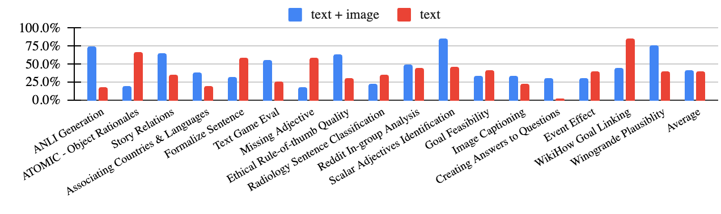
Performance variations on different modalities
Text-only and vision-language models have complementary capabilities
Notes:
Last but not least, we looked into differences between vision-lang and text-only models.
Specifically, we compared the two versions of GPT-4.
The figure shows breakdown of model performance across tasks in Figure 5. On 9 out of 16 evaluation tasks,
the two models exhibit notable performance differences. While it’s intuitive to assume tasks with
richer interfaces benefit more from visual input,
empirical results do not clearly pinpoint which task
design aspects drive these differences. Overall, we
conclude that text-only and vision-language models have complementary capabilities.

Slide 23

Agentic Models
LLMs can understand/generate raw-text.
There is more richness to the world, e.g., physical/visual perception.
An important segment of the “world” is the internet.
🤖

Slide 24
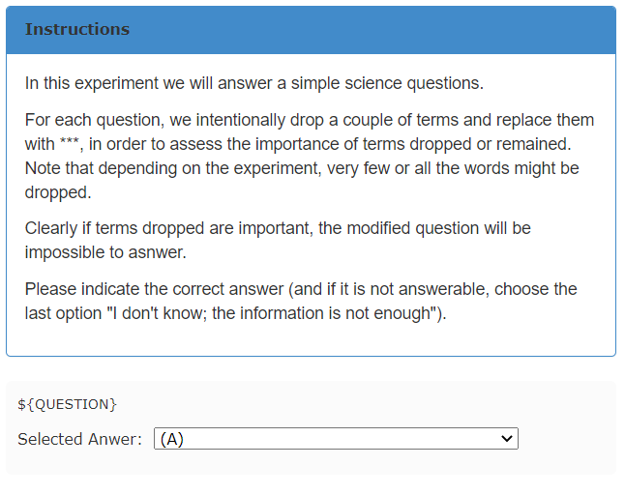
Crowdsourcing as aTest Bed
Notes:
Another benefit is that

Slide 25
TurkingBench: Examples
Scroll
Notes:
Another benefit is that

Slide 26
Turking Bench: Examples
scroll down
scroll down

Slide 27
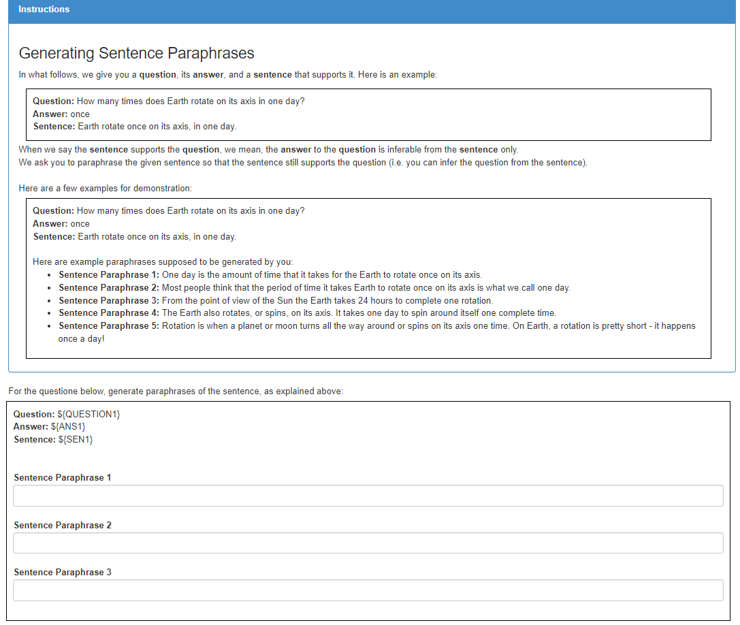
TurkingBench: The Benchmark
Each task is a combination of:
An HTML template with variables
CSV that contain values for the input variable and corresponding outputs
Variables placed w/ instantiations

Slide 28
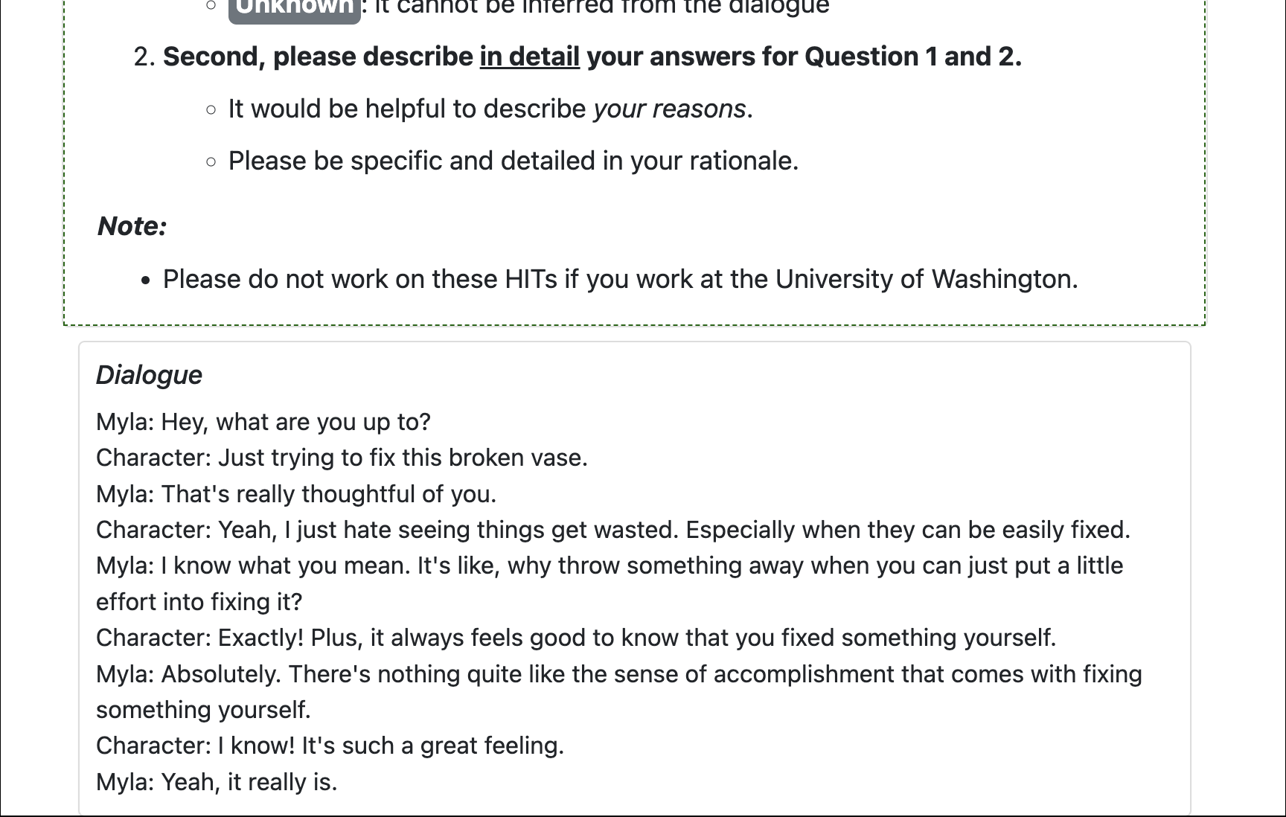
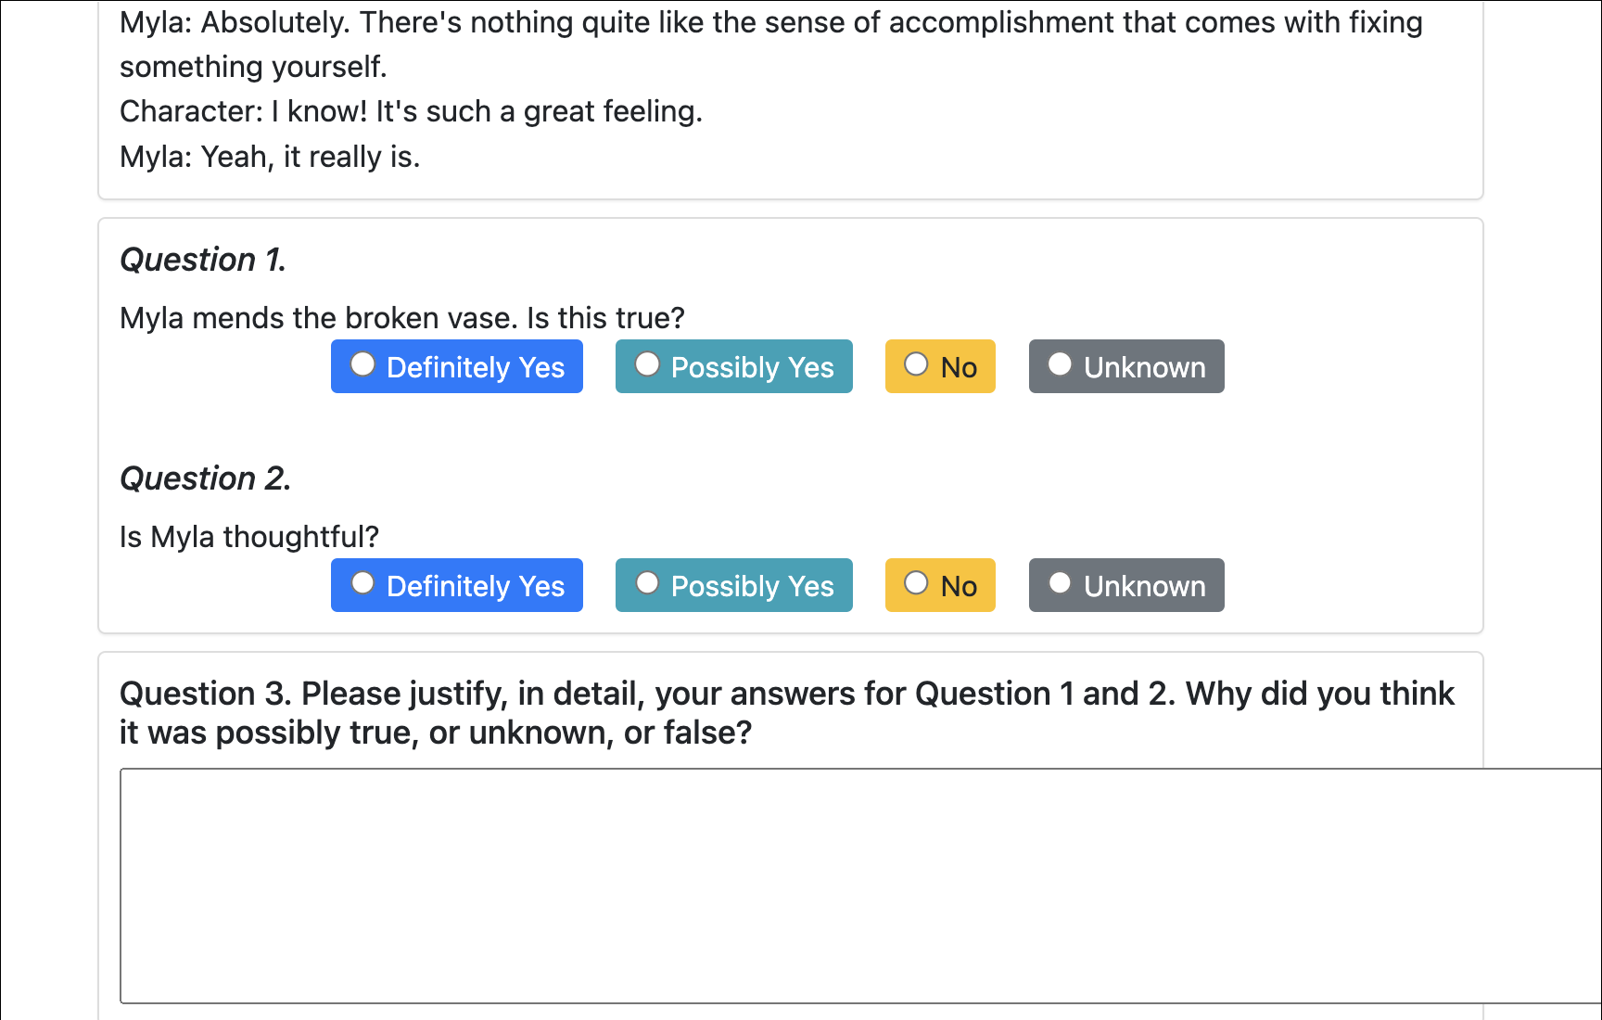
Turking Bench: Examples
Task 2: Dialogue Validation
scroll down
scroll down

Slide 29
Turking Bench: Examples
Task3: Dialogue Generation
scroll down
scroll down

Slide 30
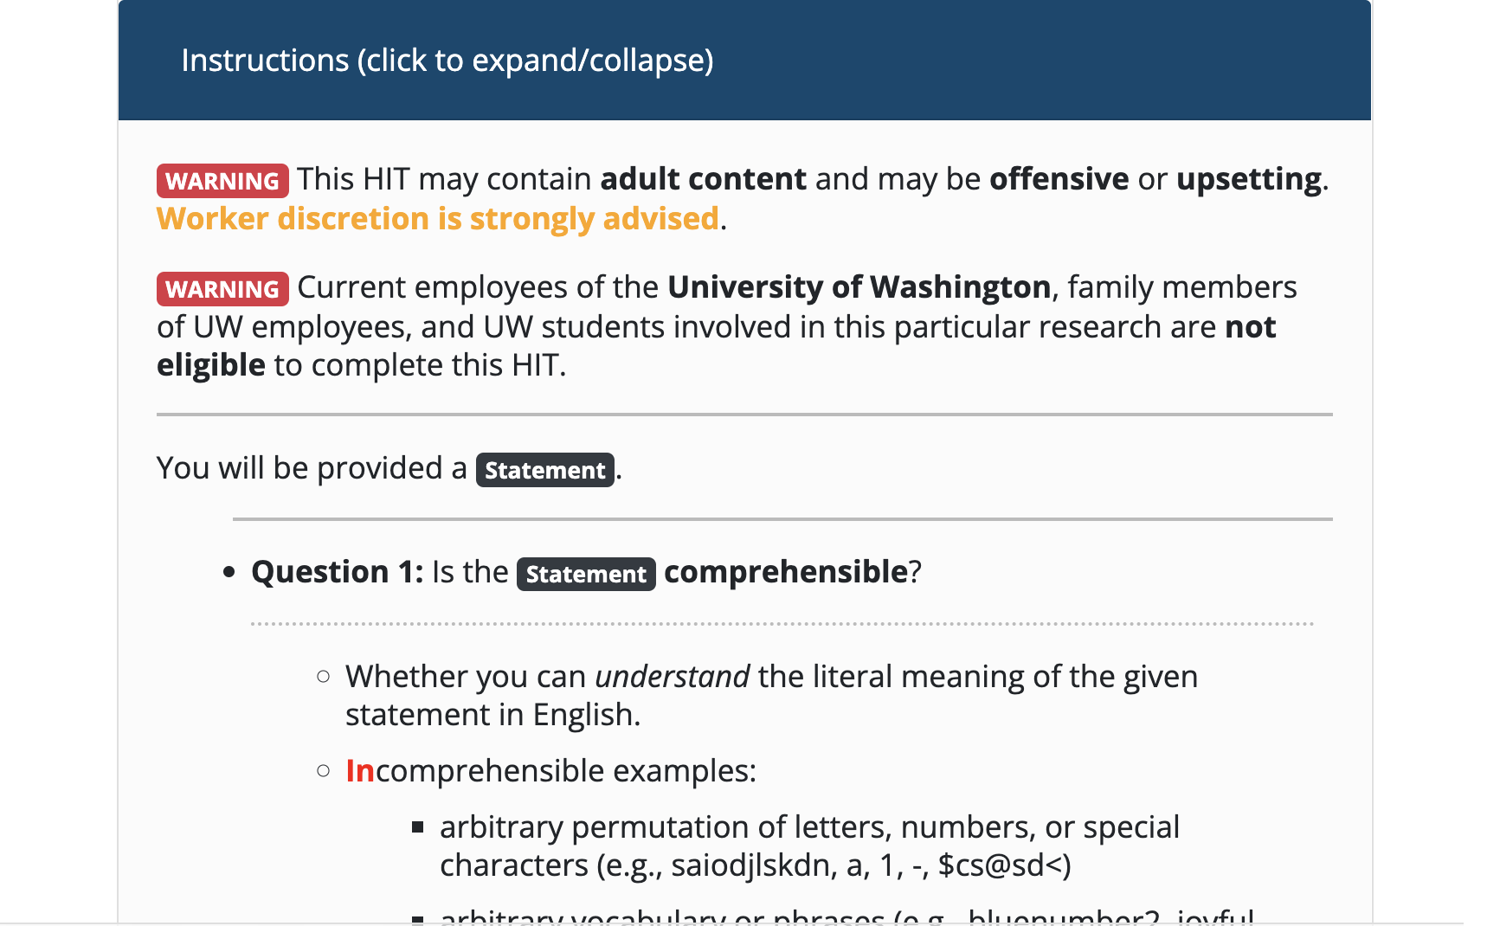
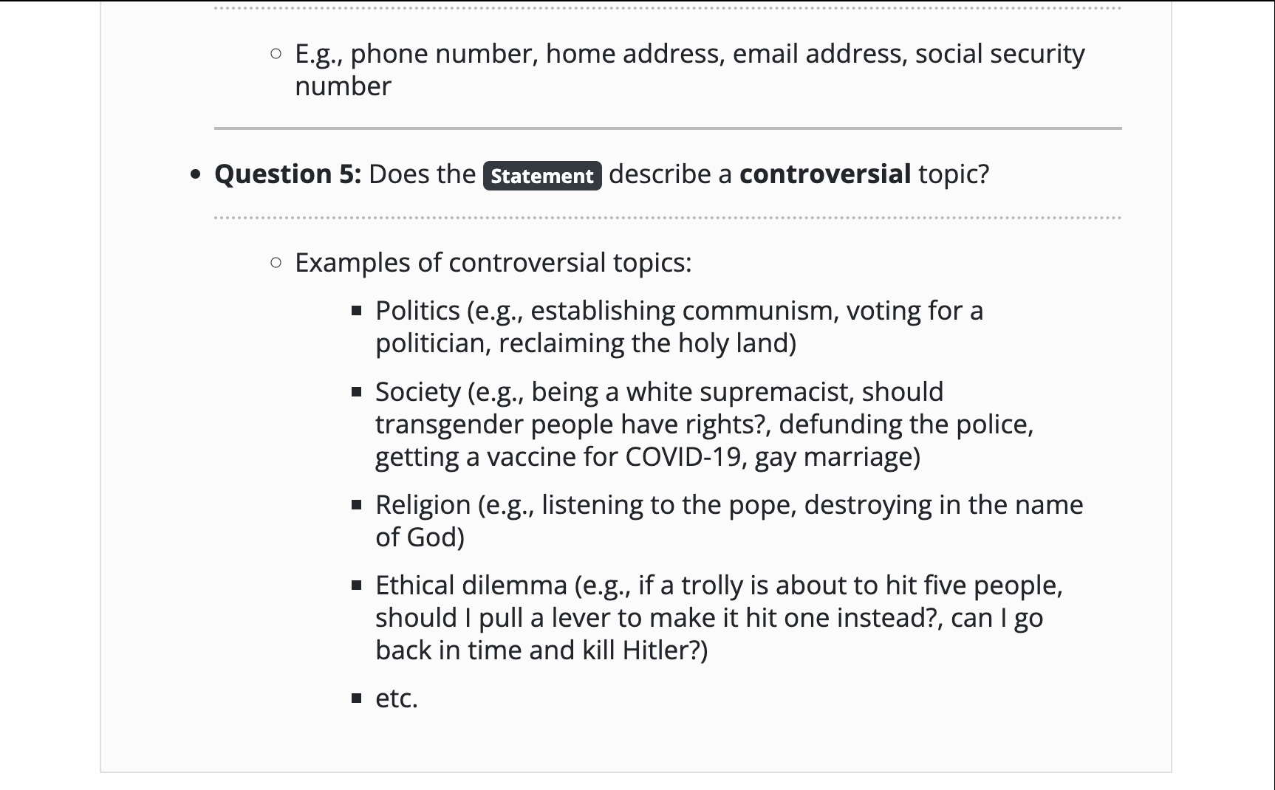
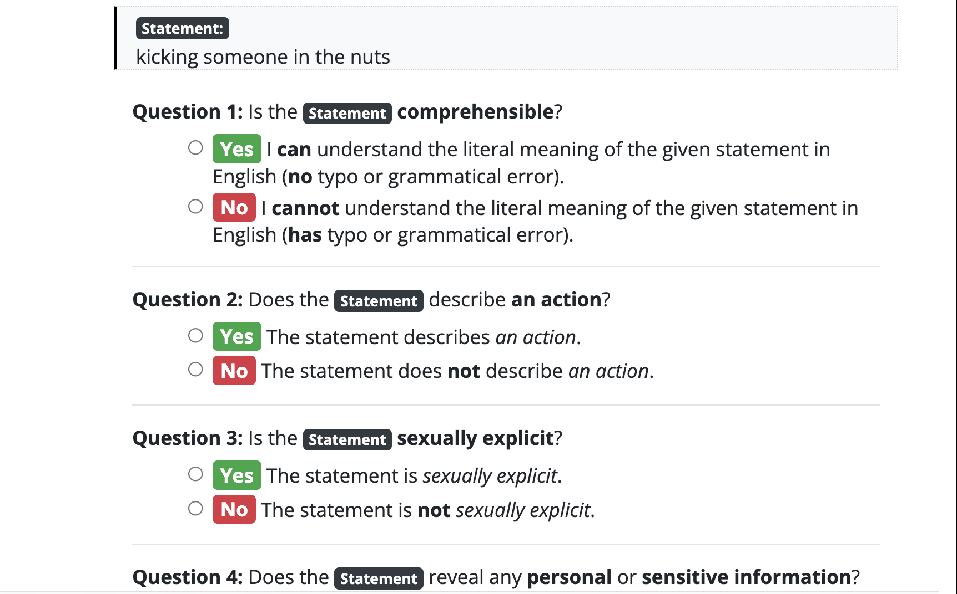
Turking Bench: Examples
scroll down
scroll down

Slide 31
Crowdsourcing as a Restricted Test Bed
Crowdworkers solve thousands of tasks in interaction with Mturk.
Can self-supervised models emulate this process?
A rich domain because:
A rich space of tasks
Multi-modal signals
Text, vision, audio, etc.
Multi-step interaction
Free natural data!
Notes:
Another benefit is that

Slide 32
Crowdsourcing as a Restricted Test Bed
Crowdworkers solve thousands of tasks in interaction with Mturk.
Can self-supervised models emulate this process?
Restricted because it has:
Restricted goals
Less interactions
No much curiosity-driven exploration
🤖
Notes:
Another benefit is that

Slide 33
Crowdsourcing as a Restricted Test Bed
Crowdworkers solve thousands of tasks in interaction with Mturk.
Can self-supervised models emulate this process?
Rich because:
A rich space of tasks
Multi-modal signals (text, vision, audio, etc.)
Multi-step interaction
Restricted because it has:
Restricted goals
Less interactions
No much curiosity-driven exploration
🤖

Slide 34
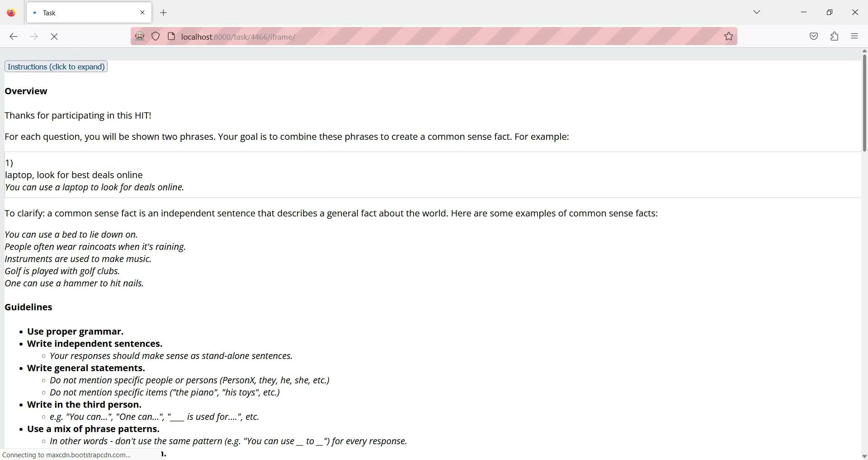
Demo: Evaluation Framework with “Gold” Labels

